Slide 1
A project Report on DEMO WEBSITE USING AUTOMATION TOOL SELENIUM WEBDRIVER WITH JAVA.
By
Bhagyashree Patil
Batch-EON (2021-5532)
Under the Guidance of,
Amruta Deore
(Technical Trainer)
EduBridge India Pvt. Ltd.

Slide 2
Introduction:
This Project aims to do overall testing like functional testing, GUI testing on Demo GlobalSQA website to check quality of application using selenium web driver. It helps to improve quality of website and saves time for manually doing this testing.
In this project our main focus is to test the Multiple Module. A Automation website is usually seeking to appeal to a broad audience and often has a Product of information to share with that audience.
Software Requirements:
Operating System: Windows 10
Browser: Latest version of Google Chrome
Platform: Eclipse IDE
Automation Tool and Language: Selenium WebDriver, Java
Files: JDK, Selenium Jar files, Common IO file

Slide 3
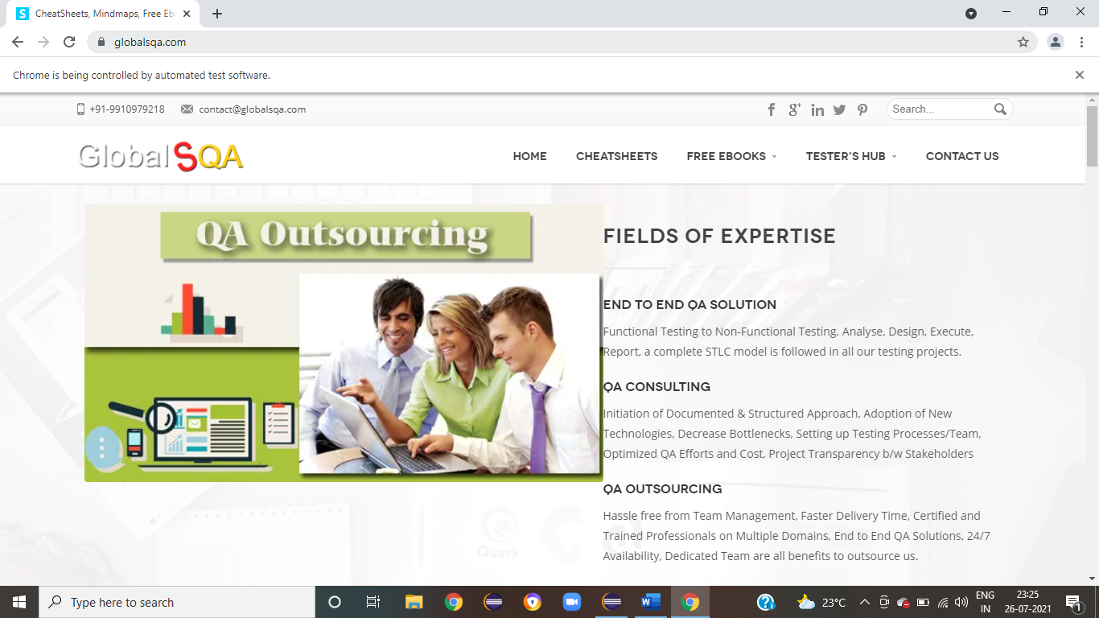
Launch the browser and Demo Global SQA website
System.setProperty("webdriver.chrome.driver","C:\\Seleniumwebdriver\\chromedriver\\chromedriver_win32\\chromedriver.exe");
WebDriver driver=new ChromeDriver();
String baseURL = ("https://www.globalsqa.com/");
driver.get(baseURL);
driver.manage().timeouts().implicitlyWait(200, TimeUnit.MILLISECONDS);
driver.manage().window().maximize();

Slide 4
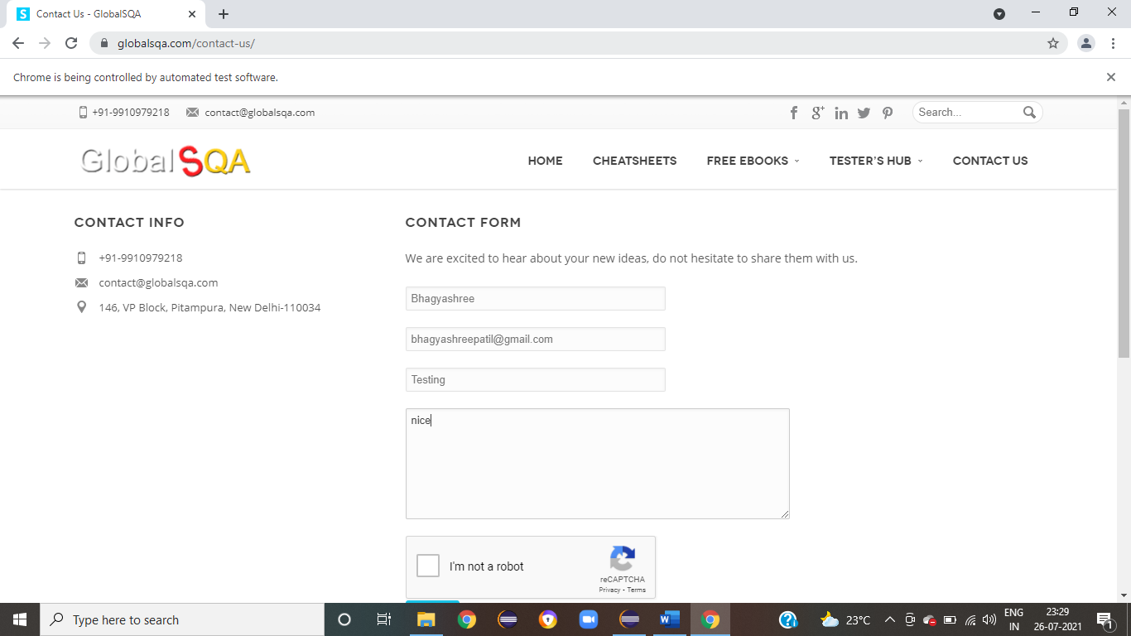
TC2:1 = To verify the functionality of contact us Form.
driver.findElement(By.xpath("//*[@id=\"menu-item-1561\"]/a")).click();
driver.findElement(By.name("comment_name")).sendKeys("Bhagyashree");
driver.findElement(By.name("email")).sendKeys("bhagyashreepatil@gmail.com");
driver.findElement(By.name("subject")).sendKeys("Testing ");
driver.findElement(By.name("comment")).sendKeys("nice");
driver.findElement(By.id("recaptcha-anchor-label")).click();
driver.findElement(By.id("submit")).click();

Slide 5
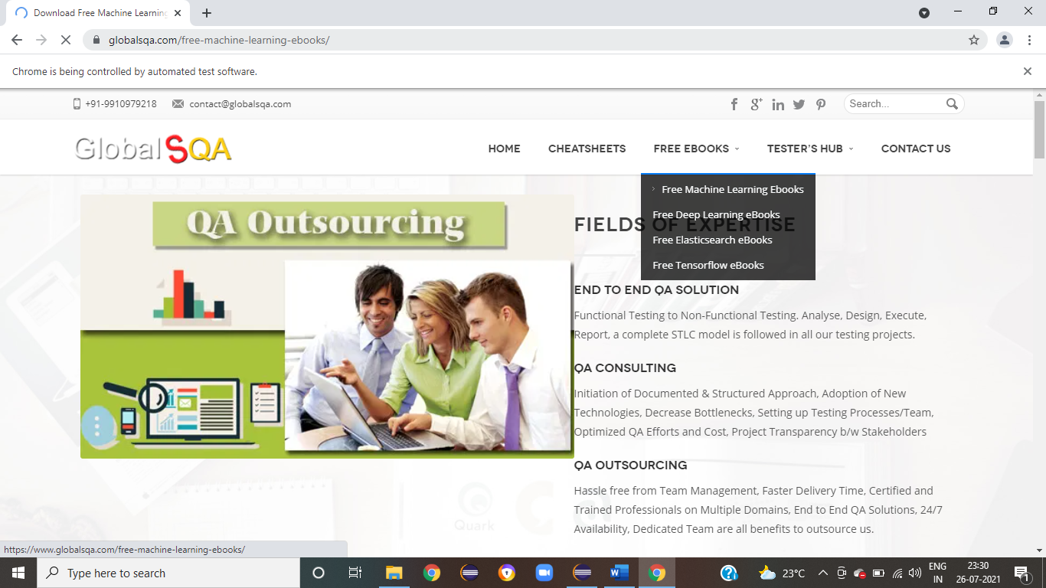
To verify and display the FreeBooks Menu of Current page of browser.
Actions actions = new Actions(driver);
WebElement FreeBooks = driver.findElement(By.xpath("/html/body/div/header/div[2]/div/div/div[3]/div/ul/li[3]/a"));
actions.moveToElement(FreeBooks);
WebElement subMenu = driver.findElement(By.cssSelector("#menu-item-7132 > a > span"));
actions.moveToElement(subMenu);
actions.doubleClick(subMenu).perform();
System.out.println(" Free machine Learning EBooks Open ");

Slide 6
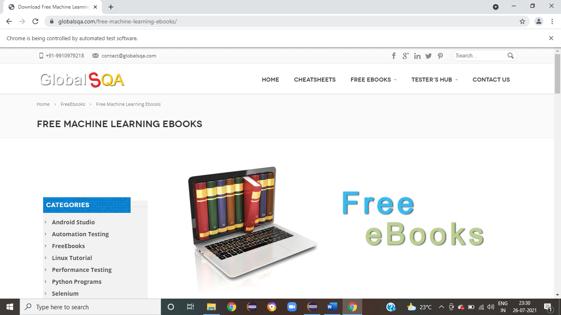
To verify the functionality of Free machine Learning EBooks Categories
JavascriptExecutor js = (JavascriptExecutor) driver; js.executeScript("window.scrollBy(0,400)");
try {
Thread.sleep(2000);
} catch (InterruptedException e)
{
e.printStackTrace();
} System.out.print(" Scroll Down");

Slide 7
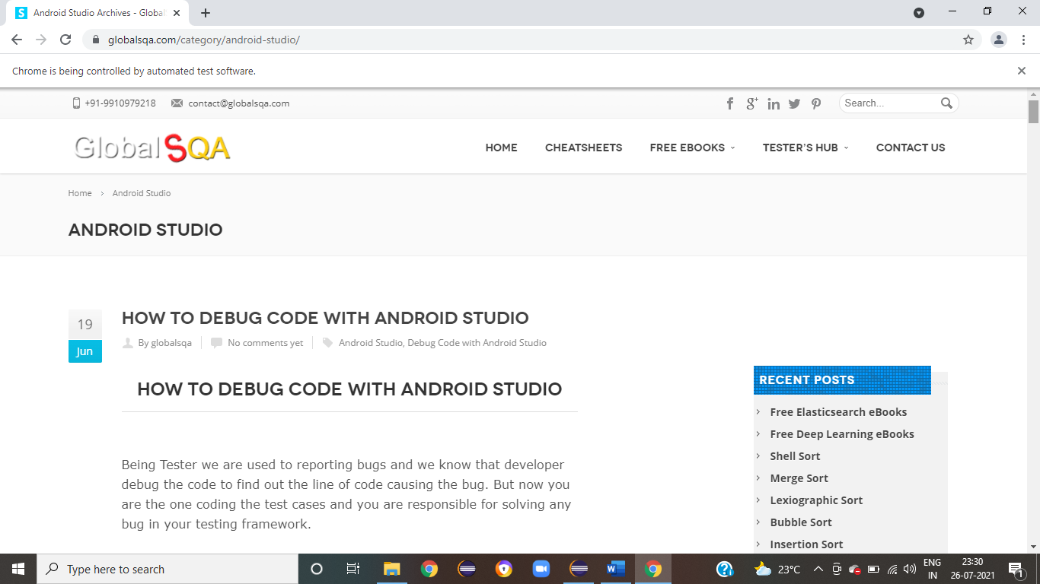
To verify the functionality of scroll down in Current page
driver.findElement(By.xpath("/html/body/div[1]/div[1]/div[2]/div/div[2]/div[1]/ul/li[1]/a/span[2]")).click();
System.out.println(" Android Studio Categories Open ");

Slide 8
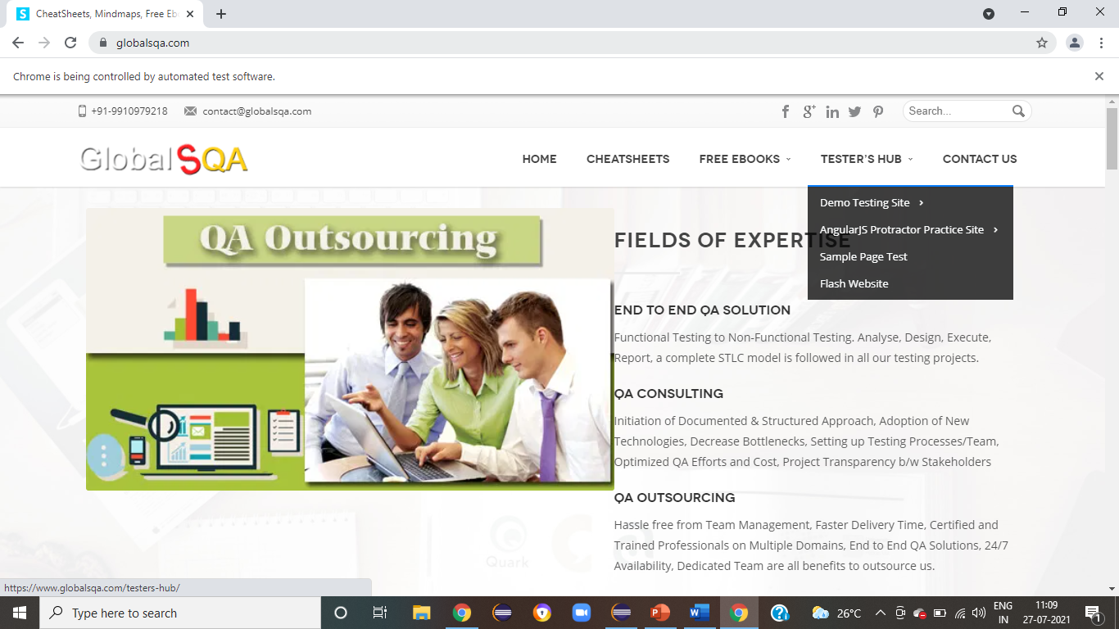
To verify and display the Tester's Hub Menu of the current page
WebElement TesterHub = driver.findElement(By.xpath("/html/body/div/header/div[2]/div/div/div[3]/div/ul/li[4]/a"));
Actions action = new Actions(driver);
action.moveToElement(TesterHub).build().perform();

Slide 9
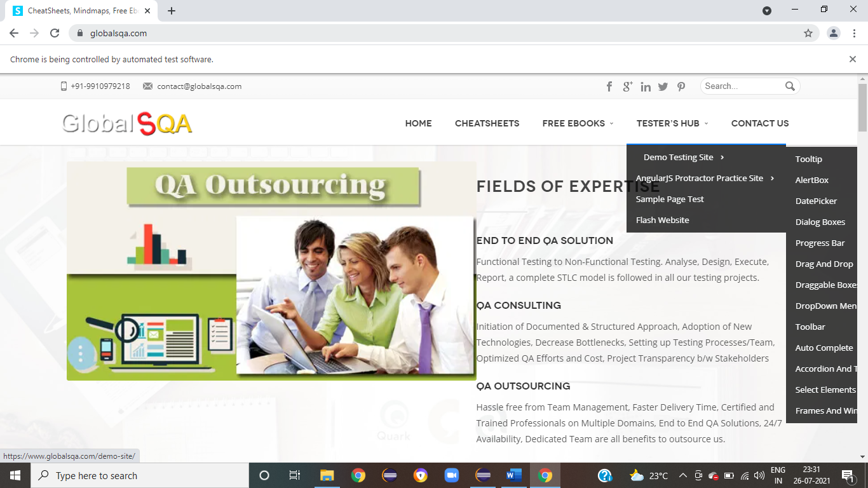
To verify the functionality of Demo Testing Site
WebElement DemoTsting = driver.findElement(By.xpath("/html/body/div/header/div[2]/div/div/div[3]/div/ul/li[4]/div/ul/li[1]/a/span/span"));
action.moveToElement(DemoTsting).build().perform();

Slide 10
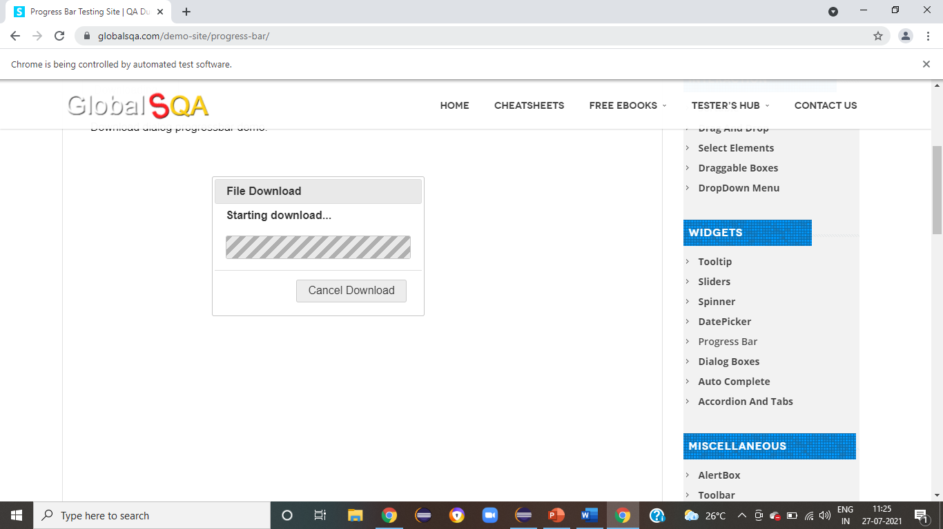
To verify the functionality of Submenu Progress Bar From Demo Testing Site
//Progress Bar
driver.findElement(By.xpath("/html/body/div/header/div[2]/div/div/div[3]/div/ul/li[4]/div/ul/li[1]/div/ul/li[5]/a/span")).click();
WebElement iframe =driver.findElement(By.xpath("//body/div[@id='wrapper']/div[1]/div[2]/div[1]/div[1]/div[2]/div[1]/div[1]/div[1]/p[1]/iframe[1]"));
driver.switchTo().frame(iframe);
System.out.println("*We are switch to the iframe");
driver.findElement(By.id("downloadButton")).click();
System.out.println(" Start download ");

Slide 11
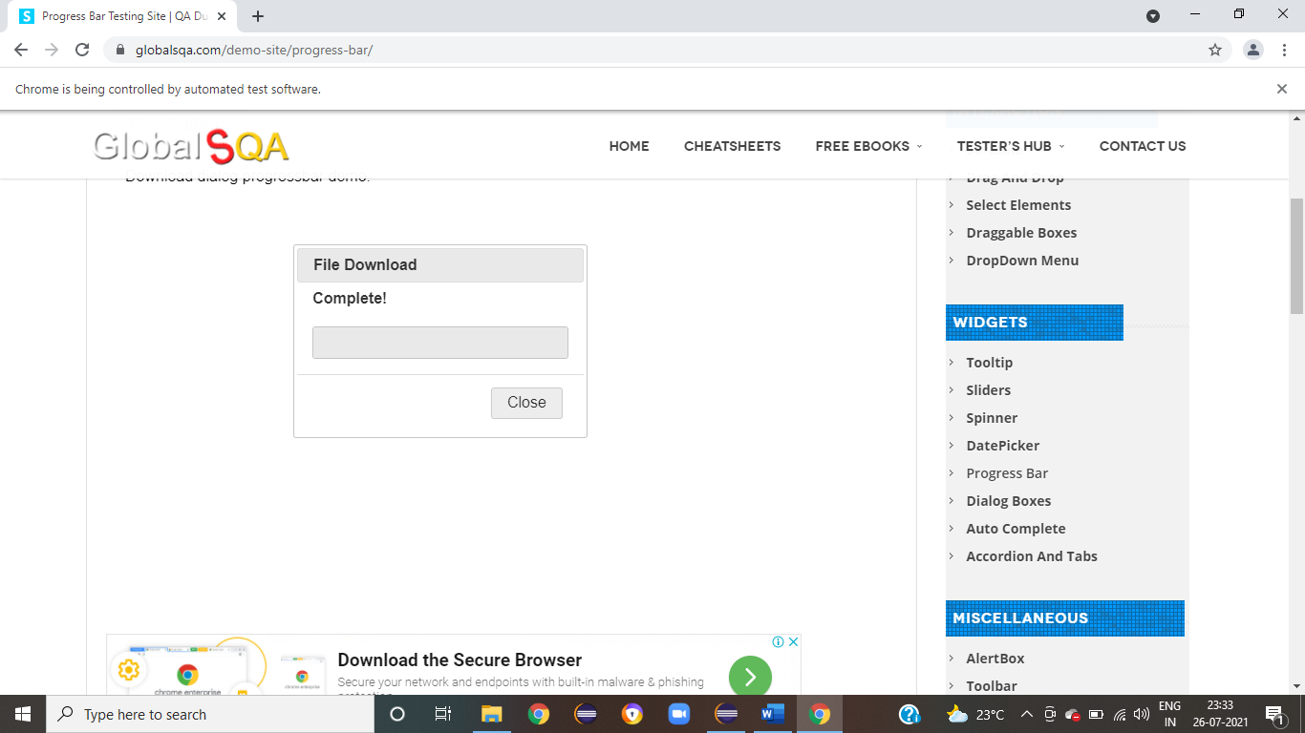
To verify the functionality of Close Button Click
driver.findElement(By.xpath("/html/body/div[2]/div[3]/div/button")).click();
System.out.println(" Close Button Click ");

Slide 12
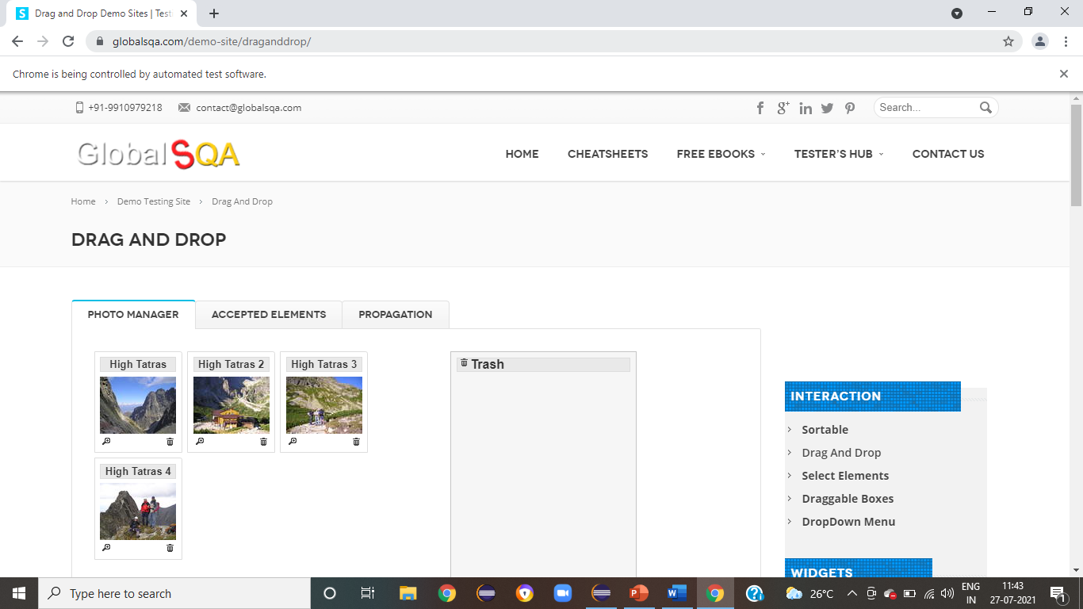
To verify the functionality of Drag
driver.findElement(By.xpath("/html/body/div/header/div[2]/div/div/div[3]/div/ul/li[4]/div/ul/li[1]/div/ul/li[6]/a/span")).click();
WebElement iframe =driver.findElement(By.xpath("/html/body/div/div[1]/div[2]/div/div/div[2]/div/div/div[1]/p/iframe"));
driver.switchTo().frame(iframe);
System.out.println("*We are switch to the iframe");
//find element which we want to drag
Actions act = new Actions (driver);
WebElement from= driver.findElement(By.xpath("/html/body/div[1]/ul/li[1]/img"));

Slide 13
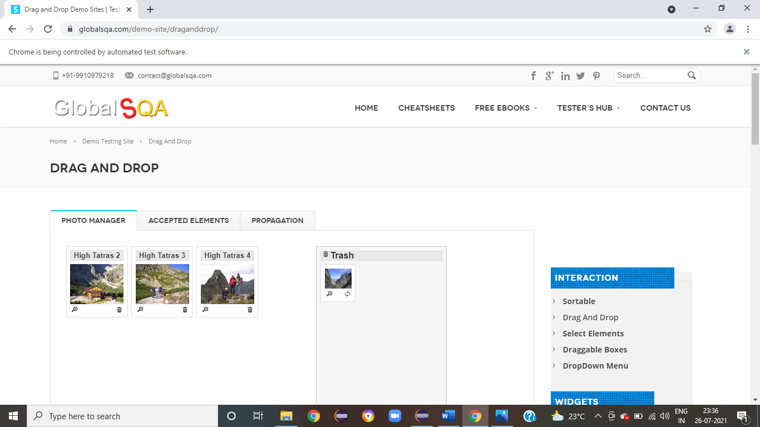
To verify the functionality of Drop
// find element which we need to drop
WebElement to= driver.findElement(By.xpath("/html/body/div[1]/div"));
// this will drag element to destination
act.dragAndDrop(from, to).build().perform();
System.out.println("Img drop to trash");

Slide 14
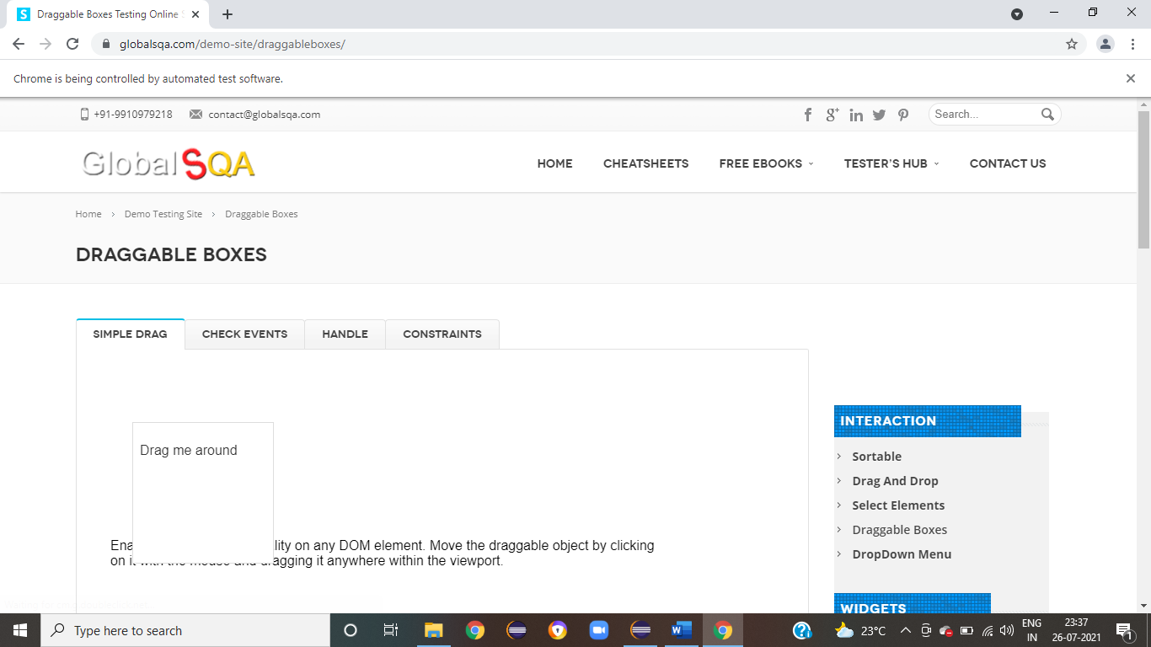
To verify the functionality of Draggable Boxes Location
driver.findElement(By.xpath("//span[contains(text(),'Draggable Boxes')]")).click();
WebElement iframe =driver.findElement(By.xpath("//body/div[@id='wrapper']/div[1]/div[2]/div[1]/div[1]/div[2]/div[1]/div[1]/div[1]/p[1]/iframe[1]"));
driver.switchTo().frame(iframe);
System.out.println("Switch to frame");
//get the location of dragable box
Point myPoint = driver.findElement(By.id("draggable")).getLocation();
System.out.println("location of dragable box :"+myPoint.x+ " "+myPoint.y);

Slide 15
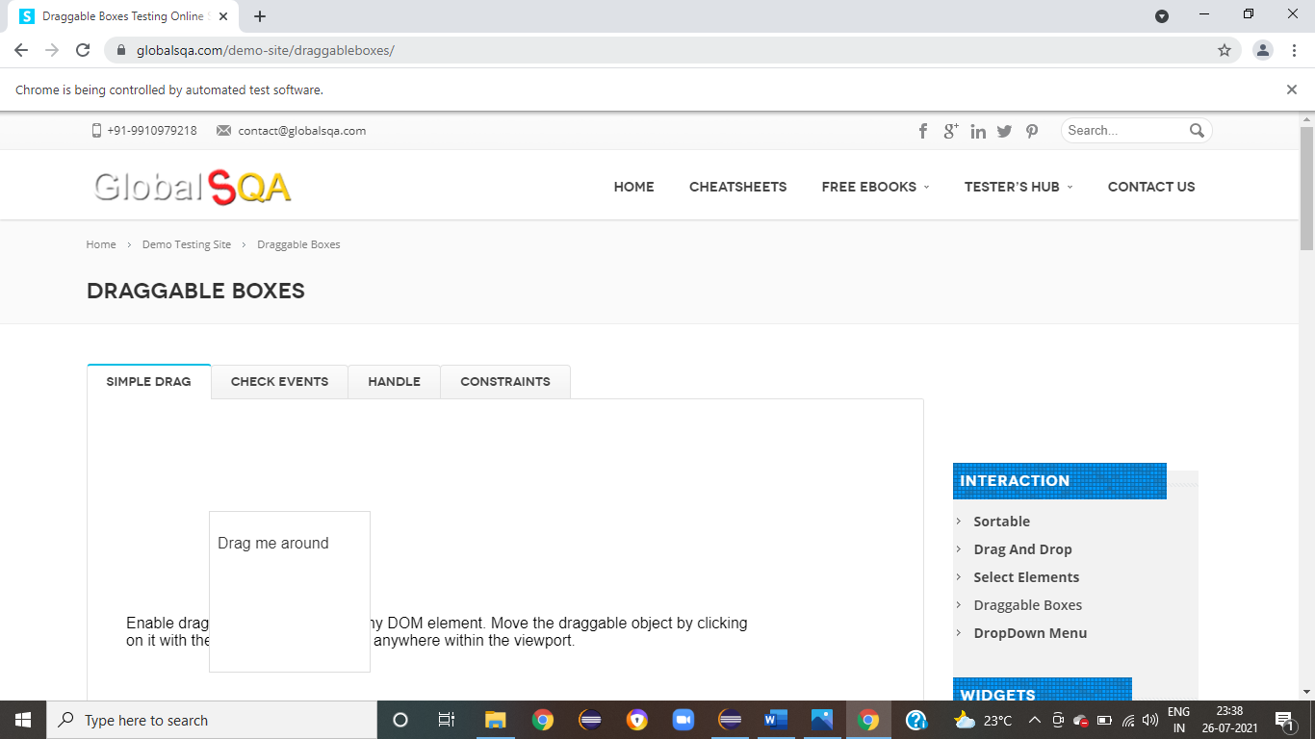
To verify the functionality of Drag Boxes And Drop for Current Page
WebElement drag =driver.findElement(By.id("draggable"));
new Actions(driver).dragAndDropBy(drag, myPoint.x + 90, myPoint.y + 80).build().perform();

Slide 16
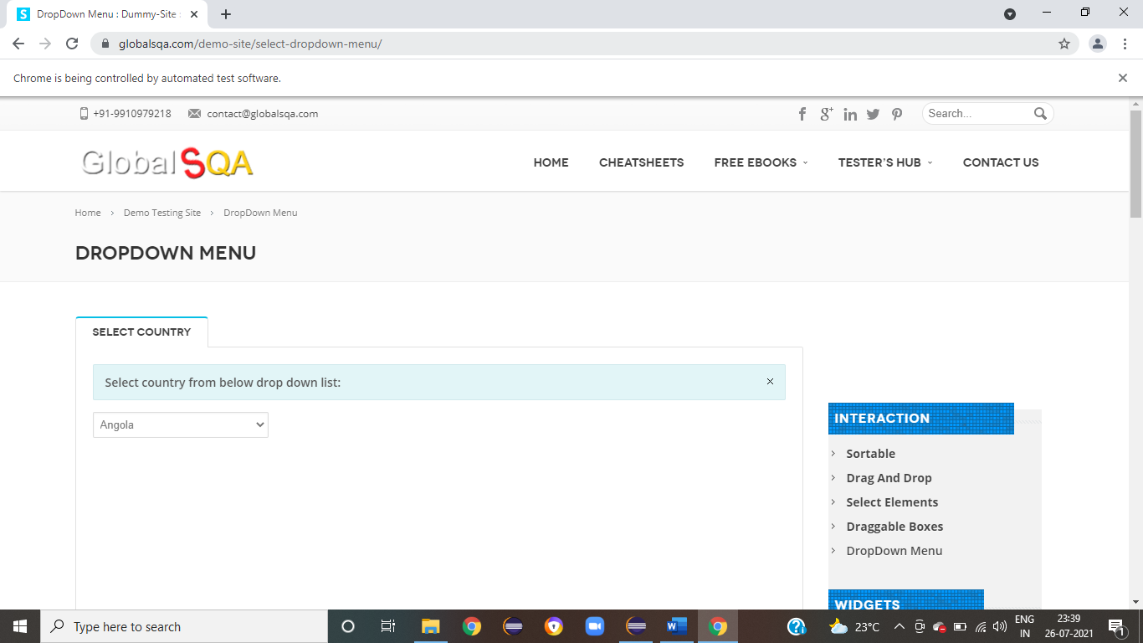
To verify the functionality of Submenu DropDown
driver.findElement(By.xpath("/html/body/div/header/div[2]/div/div/div[3]/div/ul/li[4]/div/ul/li[1]/div/ul/li[8]/a/span")).click();
WebElement iframe =driver.findElement(By.xpath("/html/body/div/div[1]/div[2]/div/div/div[2]/div/ul/li"));
System.out.println("*We are switch to the iframe");
Select drplist = new Select(driver.findElement(By.xpath("//*[@id=\"post-2646\"]/div[2]/div/div/div/p/select")));
drplist.selectByVisibleText("Angola");
drplist.selectByIndex(6);
drplist.selectByValue("Angola");

Slide 17
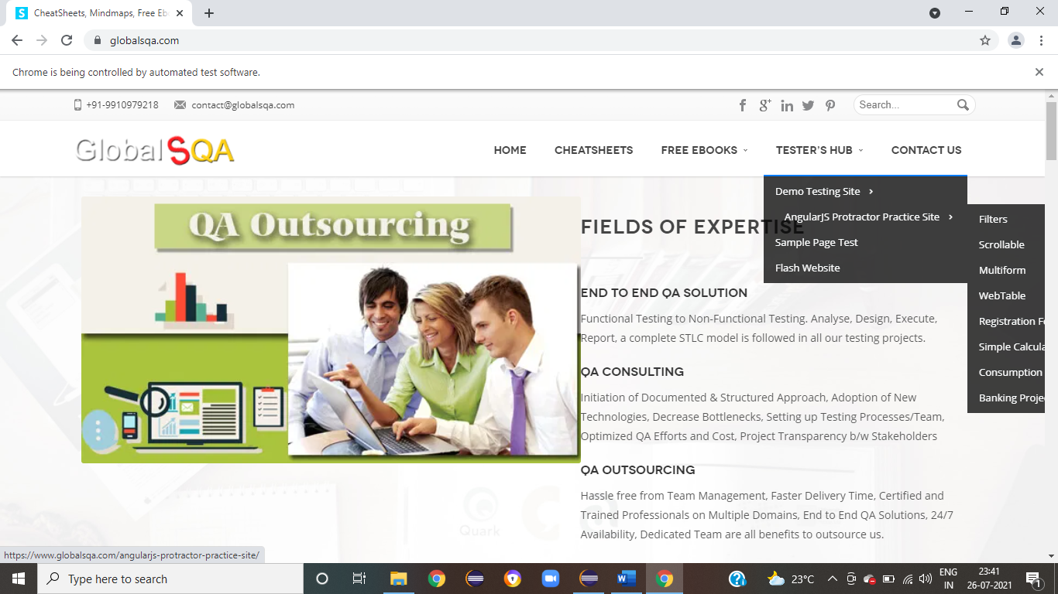
To verify the functionality of AngularJS Protractor Practice Site
WebElement TesterHub = driver.findElement(By.xpath("/html/body/div/header/div[2]/div/div/div[3]/div/ul/li[4]/a"));
Actions action = new Actions(driver);
action.moveToElement(TesterHub).build().perform();
WebElement APPS = driver.findElement(By.xpath("/html/body/div/header/div[2]/div/div/div[3]/div/ul/li[4]/div/ul/li[2]/a/span"));
action.moveToElement(APPS).build().perform();

Slide 18
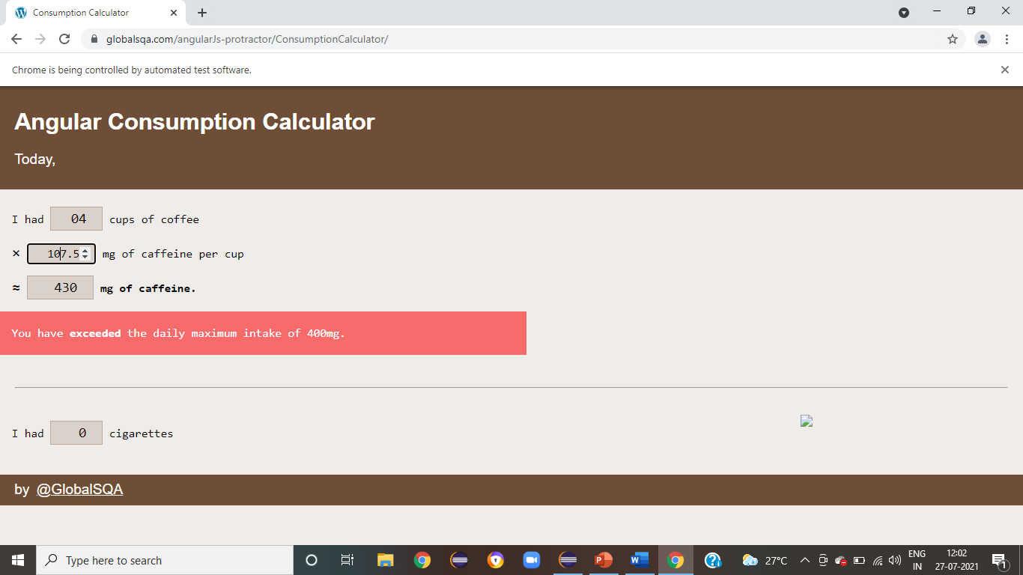
To verify the functionality of Angular Consumption Calculator
//Angular Consumption Calculator
driver.findElement(By.xpath("/html/body/div/header/div[2]/div/div/div[3]/div/ul/li[4]/div/ul/li[2]/div/ul/li[7]/a/span")).click();
List<WebElement> elements = driver.findElements(By.name("quantity"));
// TO check cups of coffee
driver.findElement(By.name("quantity")).sendKeys("4");
driver.findElement(By.name("perUnit")).click();
System.out.println(" the daily maximum intake of 400mg.");

Slide 19
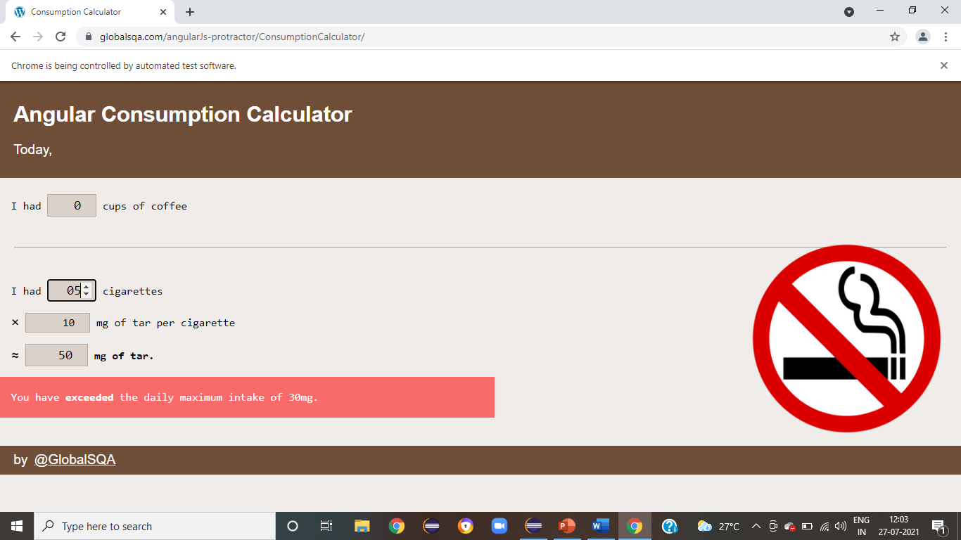
To verify the functionality of Angular Consumption Calculator
// To Check cigarettes
driver.findElement(By.xpath("/html/body/form[2]/p/input")).sendKeys("5");
driver.findElement(By.name("perUnit")).click();
System.out.println(" the daily maximum intake of 30mg.");

Slide 20
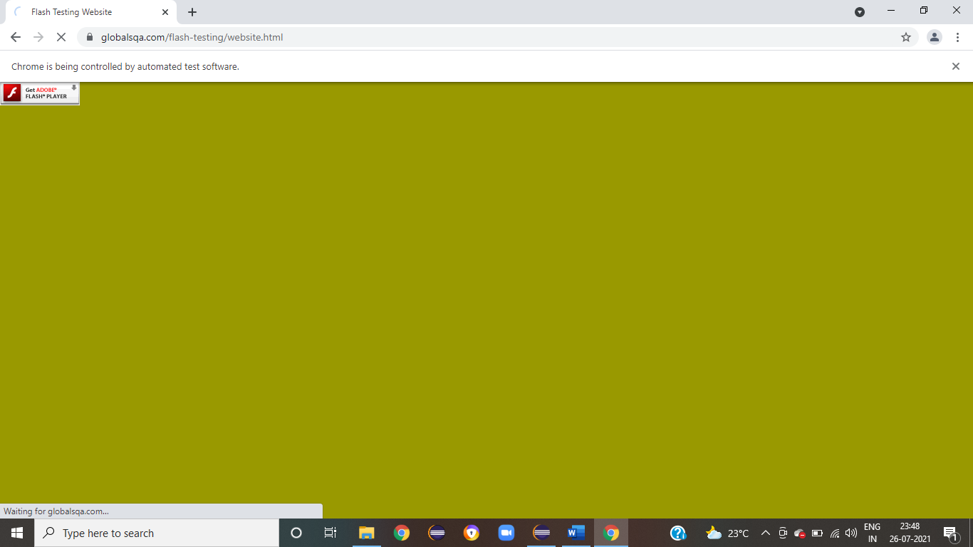
To verify the functionality of Flash Website From Tester Hub Menu
WebElement TesterHub = driver.findElement(By.xpath("/html/body/div/header/div[2]/div/div/div[3]/div/ul/li[4]/a"));
Actions action = new Actions(driver);
action.moveToElement(TesterHub).build().perform();
WebElement Fw = driver.findElement(By.xpath("/html/body/div/header/div[2]/div/div/div[3]/div/ul/li[4]/div/ul/li[4]/a/span"));
Fw.click();

Slide 21
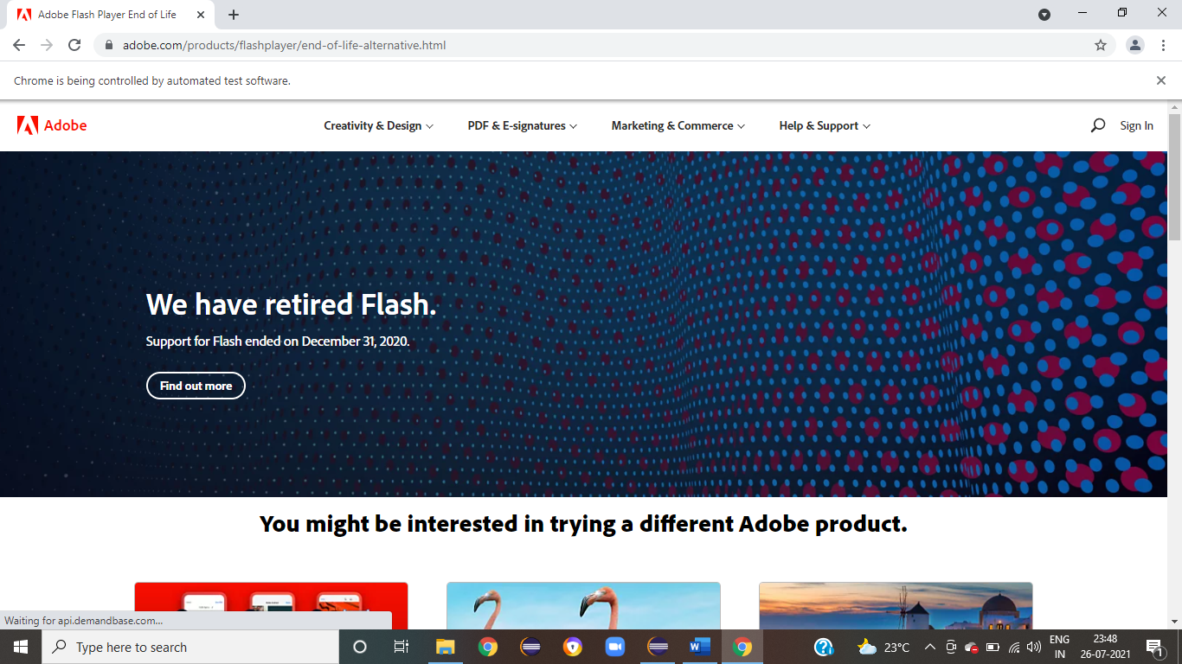
To verify the functionality of Click The Check Box
driver.findElement(By.xpath("/html/body/div/object/object/a/img")).click();
System.out.println(" Open the adobe.com site");

Slide 22
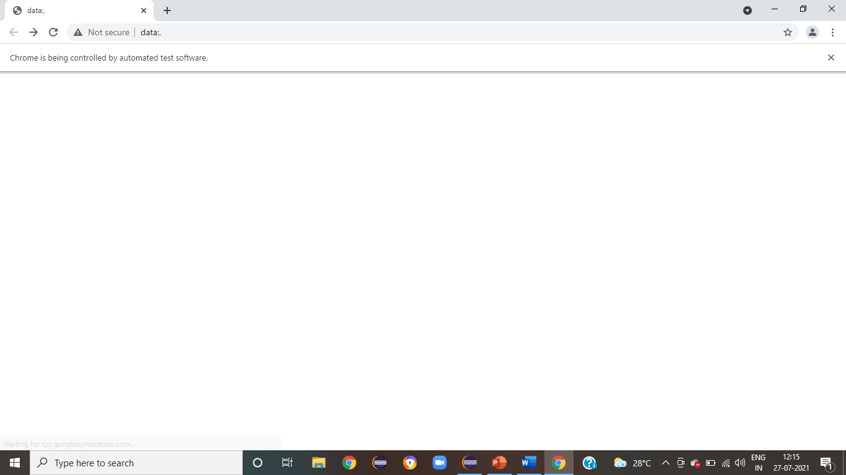
To verify the navigation to go back to previous page.
// go back to previous page.
driver.navigate().back();

Slide 23
To verify the navigation to go back to previous page.
//Close the WEb page
driver.close();

Slide 24
THANK YOU

